Slide 1

BE Sem. VII: Project Proposal Presentation (AY:2025-26)
WebLAPS-AI Solution : Smart Analysis, Smarter Conversations
Presented by
Sakshi Khalate – 25
Layba Khan – 26
Parshwa Mehta– 27
Atharva Mohite– 28
Under the guidance
of
Dr.Jayasudha Koti
Department of Electronics and Telecommunication Engineering
St. Francis Institute of Technology, Mumbai

Slide 2
Contents
Introduction and Motivation
Problem Statement
Objectives
Flow Chart
Literature Review
Software Requirements
Integration of AI and Cyber security
Vulnerabilities That We Aim To Solve
Requirement of Security in Applications
References

Slide 3
Introduction
This project is about building a simple tool to help users find and fix security weaknesses (VULNERABILITIES) in web applications. Our tool has two parts:- A dashboard that gives a clear overview of all the security problems, and a friendly (INTERACTIVE) chatbot. When you want to fix a problem, the chatbot will tell you a simple story to explain what went wrong and give you easy step-by-step instructions to solve it.

Slide 4
Motivation
The main reason we are making this is because most security reports are very technical and hard to understand. This makes it difficult for users to fix security issues quickly and correctly, leaving their websites at risk. We want to make security easier and less scary for everyone, not just security experts. Our goal is to make fixing problems feel more like an interactive lesson, so users can solve today's issues and learn how to avoid them in the future.

Slide 5
Problem Statement
Users often struggle to fix security weaknesses in web applications because the reports from automated scanning tools are highly technical and difficult to understand. This communication gap leads to slow or incorrect fixes, which leaves applications vulnerable to attacks. The core problem is the absence of a tool that not only identifies these security flaws but also guides non-expert users through the repair process in an interactive, simple, and educational manner.

Slide 6
Objectives
Customizable Analytics: Enable users to tailor dashboard views to their specific roles, responsibilities, and organizational requirements through conversational interfaces.
For Example:-The dashboard can be tailored to different user roles. A developer might want to see a list of vulnerabilities in the code they wrote, while a project manager might want a high-level overview of the security posture of all their projects.
Proactive Security Culture: Foster security awareness and best practices through engaging, story-based vulnerability explanations that transform technical information into actionable knowledge.
For Example:-The chatbot can engage users in proactive security practices.
Chatbot: "Congratulations on fixing the SQL Injection! Would you like a small summary about the same so that you can avoid it the next time.
Real-time Response: Provide immediate threat detection and automated response.
For Example:-An AI system can provide immediate threat detection and automated responses to minimize the window of opportunity for attackers.

Slide 7
Objectives
Enhanced Detection Accuracy: An AI-powered system can use behavioral analysis to distinguish between normal user activity and malicious behavior.
For example:- A user attempting to log in multiple times from various, geographically distant locations within a short time frame is a behavioral anomaly that could indicate a credential stuffing attack.
Intelligent Prioritization: Develop risk-based scoring systems to focus attention on critical vulnerabilities first, enabling efficient resource allocation.
For Example:-A project could develop a risk-based scoring system that assigns a score to each vulnerability, prioritizing the most critical ones. The score would be based on factors like:
1.Severity
2.Exploitability
3.Business impact
Interactive Education: Create storytelling chatbot capabilities to explain complex security concepts in accessible, narrative-driven formats that increase user engagement and retention.
For Example:-The chatbot can use storytelling to explain complex concepts. Instead of just saying "You have an SQL Injection vulnerability," it can tell a story, which can be easy for human interaction.

Slide 8
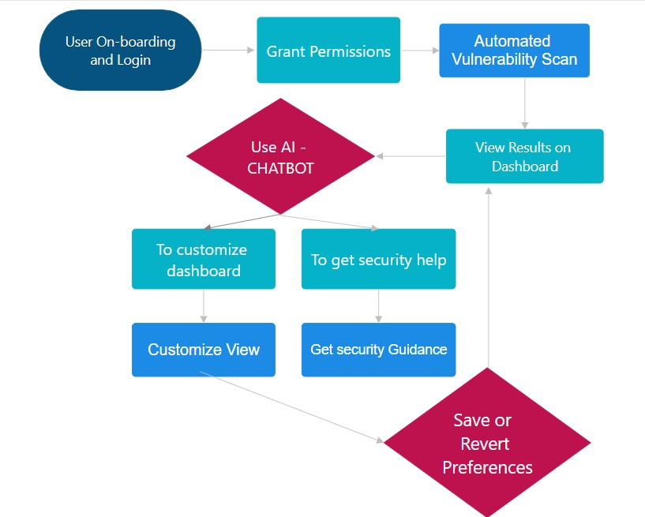
Flow Chart

Slide 9
Literature Review
Sr. No. | Title of the Paper | Author | Descriptions | Results
1. | Identifying and Mitigating Web Application Vulnerabilities: A Comparative Study of Countermeasures and Tools [1] | Sadat, Sayed Elham & Naseri, Mohammed & Salamzada, Khosraw. | The paper analyzes the most critical web application security risks, focusing on the OWASP Top 10 vulnerabilities such as Broken Access Control, Injection flaws, Security Misconfigurations, and Cryptographic Failures. | The paper summarizes the top web application security risks, including Broken Access Control, Cryptographic Failures, Injection attacks, Insecure Design, and Security Misconfigurations. It evaluates the effectiveness of open-source tools in detecting these vulnerabilities and highlights best practices for mitigation.
2. | Vulnerabilities and Security of Web Applications [2] | D. Yadav, D. Gupta, D. Singh, D. Kumar and U. Sharma | Web application vulnerabilities include common risks such as SQL injection, cross-site scripting (XSS), broken authentication, XML External Entities (XXE), security misconfigurations, and file upload flaws. | Web application security is essential to protect sensitive data and ensure service availability. It involves defending applications against common threats like SQL injection, cross-site scripting, and broken authentication.

Slide 10
Literature Review
Sr. No. | Title of the Paper | Author | Descriptions | Results
3. | AI-Based Web Vulnerability Scanner: A Comprehensive Review [3] | Devadiga, Preeti and Varankar, Shruti and Kumari, Sneha and MISHRA, NILAMADHAB | The document reviews AI-powered web vulnerability scanners that improve accuracy by analyzing web traffic and code patterns to detect threats like SQL injection and XSS. It highlights a scorecard system that prioritizes vulnerabilities by risk, enabling efficient remediation. | The conclusion highlights that AI-enhanced vulnerability scanners significantly improve web security by increasing detection accuracy, reducing false positives, and prioritizing risks effectively through a scorecard system. This approach enables faster, focused remediation of critical threats and adapts continuously to emerging vulnerabilities.
4. | An Automatic Vulnerability Scanner for Web Applications with Firewall Techniques [4] | Rathod , S.K. Jagtap , J.R. Satpute , A. P. Shikhare , K.A. Pujari , A.S. Pandit | Key features of a web vulnerability scanner include automated asset discovery, comprehensive vulnerability detection, risk-based prioritization, and detailed actionable reports. | The paper concludes that combining automated vulnerability scanning tools with manual testing provides the most effective cybersecurity assessment. The developed scanner is flexible and customizable, capable of detecting various web and network threats.

Slide 11
Software Requirements
Backend Framework: Python with FastAPI for high-performance API development and ML model integration.
Machine Learning Libraries: TensorFlow, PyTorch, scikit-learn for vulnerability detection algorithms and training our model .
Natural Language Processing: LangChain for orchestrating chatbot functionality , utilizing a powerful self-hosted LLM like Llama 3 for generating story-driven explanations , and spaCy for efficient initial query parsing and entity extraction.
Frontend Development: React.js for frame work , Rechart for visualization , Redux Toolkit for real time interactive components and threat detection , Material UI of Figma for ui components.
Database Systems: PostgreSQL for relational data, MongoDB for vulnerability logs and user customizations.
Scanning Engines: OWASP ZAP for web application vulnerability scanning, Nikto for rapid initial scanning identifying known vulnerabilities and common misconfigurations on the web server itself , and custom build scanning models .
Authentication: JWT tokens will be used to authenticate API requests , OAuth 2.0 will serve as the framework for authorization and potential third-party logins.
Development Environment: VS code for coding and Git-Hub for organising and saving code files in repositories

Slide 12
Integration of AI & Cyber Security
Integrating AI with cybersecurity provides:-
Spots Hidden Threats: The AI constantly sifts through your network data to find suspicious patterns and predict attacks before they happen.
Acts Instantly to Stop Attacks: The moment a threat is found, the AI can automatically take action to block malicious traffic or begin other security measures.
Focuses on What Matters Most: It intelligently prioritizes threats, allowing you to focus your energy on the most critical security issues first.
Connects the Dots: The AI analyzes data from multiple sources at once to give you a complete picture of a potential threat. In this project, the AI modules are designed to process real-time network traffic, flag suspicious activity, and even auto-mitigate threats.

Slide 13
Vulnerabilities That We Aim To Solve
XSS (Cross-Site Scripting) & CSRF (Cross-Site Request Forgery): XSS allows attackers to inject malicious scripts into a website viewed by other users, potentially stealing data or hijacking sessions. CSRF tricks a logged-in user into performing unwanted actions on a web application (e.g., changing their email or transferring funds).
SQL Injection (SQLi): Attackers inject malicious SQL code into input fields, allowing them to view, modify, or delete data in the application's database, leading to data theft or loss of integrity.
Buffer Overflow: Occurs when a program tries to write more data to a fixed-length memory block (buffer) than it can hold. This can corrupt adjacent data or allow an attacker to execute malicious code.
Vulnerable & Outdated Components: Using libraries, frameworks, or other software components with known security flaws. This is a common and easily exploitable weakness if not managed.
Security Misconfigurations: This is a broad category, including default settings that aren't secured, unnecessary features that are enabled, or improper permissions that expose sensitive information.
Cryptographic Failures: Occurs when sensitive data (e.g., passwords, financial data) is not encrypted, is encrypted poorly, or is stored with weak hashing algorithms, leading to a high risk of data exposure.

Slide 14
Requirement of Security in Applications
Data Protection Imperatives: Modern web applications handle sensitive personal information, financial data, and business-critical operations. Security breaches result in average costs of $4.45 million per incident, making robust protection essential for organizational survival.
Regulatory Compliance: Applications must meet stringent requirements including GDPR, HIPAA, PCI-DSS, and SOX regulations. Non-compliance results in significant financial penalties and legal consequences.
Trust and Reputation: Security breaches damage brand reputation and customer trust, with studies showing 60% of customers stop using services after data breaches.
Business Continuity: Cyberattacks can disrupt operations for weeks, causing revenue loss and competitive disadvantage. Proactive security measures ensure operational resilience.
Evolving Threat Landscape: Cybercriminals continuously develop sophisticated attack methods. AI-powered defenses are necessary to keep pace with automated attacks and advanced persistent threats.

Slide 15
Conclusion
In conclusion, this project successfully created a user-friendly platform that makes fixing web security issues much simpler. By combining a clear dashboard with an engaging, story-telling chatbot, we have bridged the difficult gap between finding a security problem and actually solving it. This tool not only helps developers fix current threats accurately but also teaches them valuable lessons along the way. Ultimately, it empowers them to build safer, more secure applications from the start, fostering a better security culture for everyone.

Slide 16
References
AI in Cybersecurity: Latest Developments + How It's Used in 2025 - https://secureframe.com/blog/ai-in-cybersecurity
AI Dashboard Future-proofing Business Analytics: Design, Applications, and Latest Trends - https://fuselabcreative.com/ai-business-analytics-dashboard/
Vulnerabilities of Web Applications: Good Practices and New Trends - https://www.acigjournal.com/Vulnerabilities-of-Web-Applications-Good-Practices-and-New-Trends,199521,0,2.html
Web Application Scanning & API Security - https://www.qualys.com/apps/web-app-scanning/
Study of Vulnerability Scanners for Detecting SQL Injection and XSS Attack in Websites - https://ojs.bonviewpress.com/index.php/AIA/article/view/754/489
AI in Cybersecurity: Key Benefits, Defense Strategies, & Future Trends - https://www.fortinet.com/resources/cyberglossary/artificial-intelligence-in-cybersecurity

